Slide 1

RESEARCH METHODS
SHOULD INDIA LEGALIZE CRYPTOCURRENCY AND THE REPERCUSSIONS OF A BAN ON THE COUNTRY'S ECONOMY.
Presented by Group 6 : Aashna Gandhi (S052)
Kinjal Joshi (S057)
Krisha Desai (S061)

Slide 2
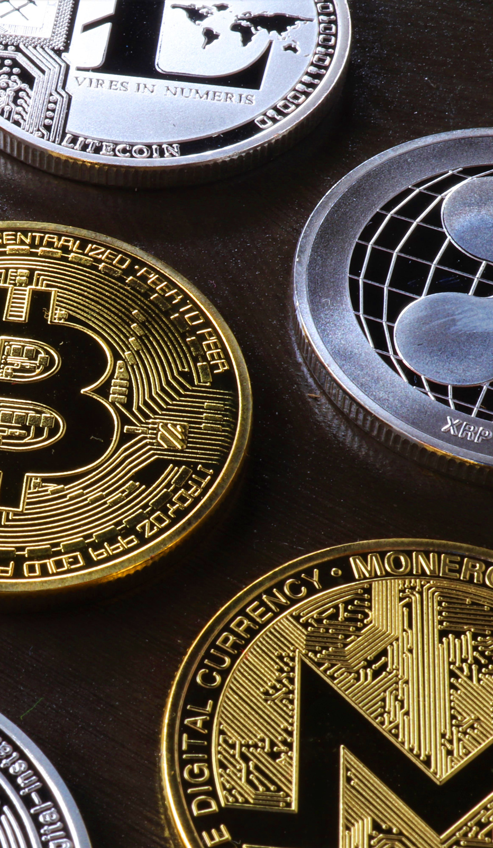
CRYPTOCURRENCY
A brief outline
An innovative concept of decentralized virtual currency.
Restrictions on the buy and sell of cryptocurrencies.
Advantages of Cryptocurrency

Slide 3
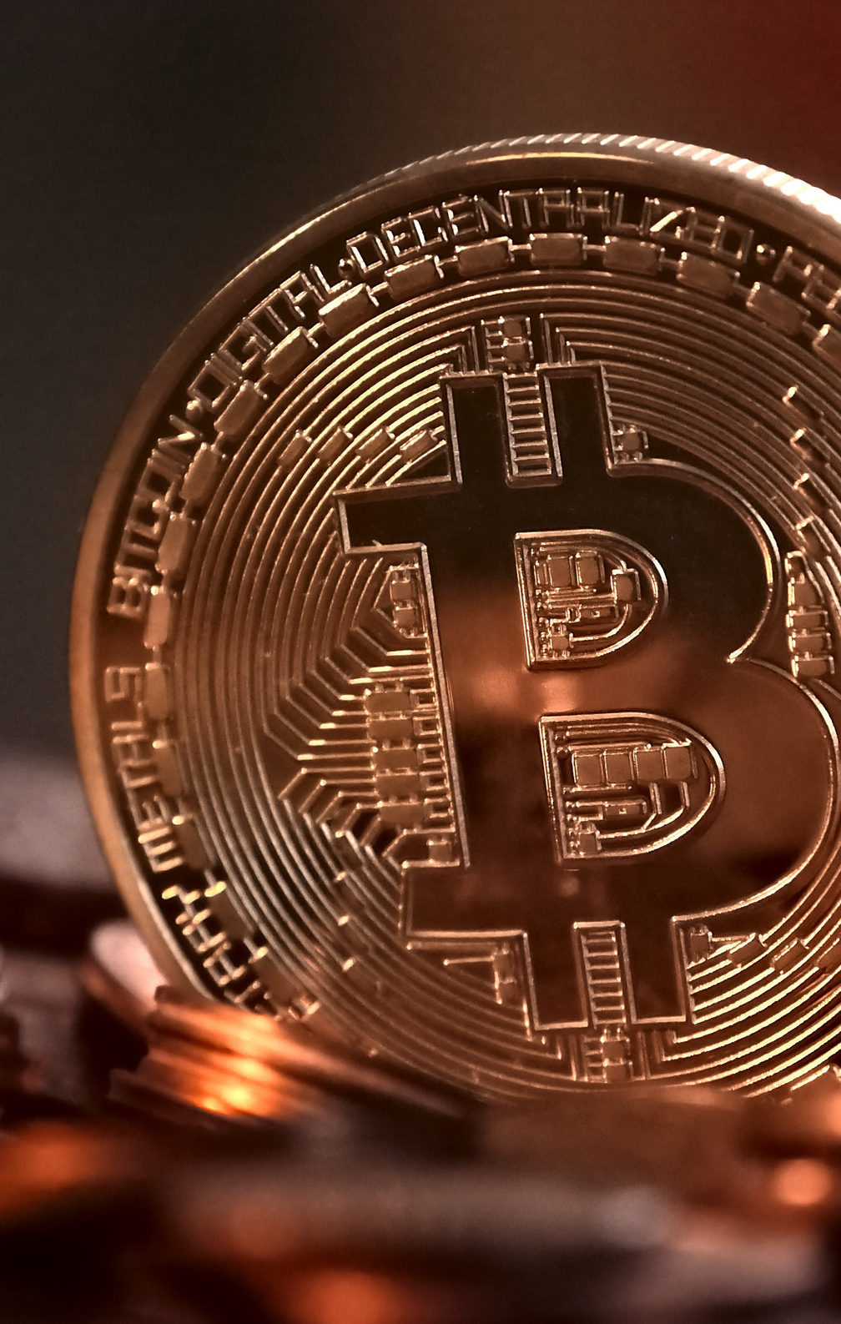
CRYPTOCURRENCY IN THE INDIAN CONTEXT
Where we are today
Cryptocurrencies have been operating within the country for a number of years now.
People with large cash holdings required a new means of holding
Realizing that fiat money isn’t exactly “real” money since it isn’t backed up by anything, Indians began to seek alternative currency models

Slide 4
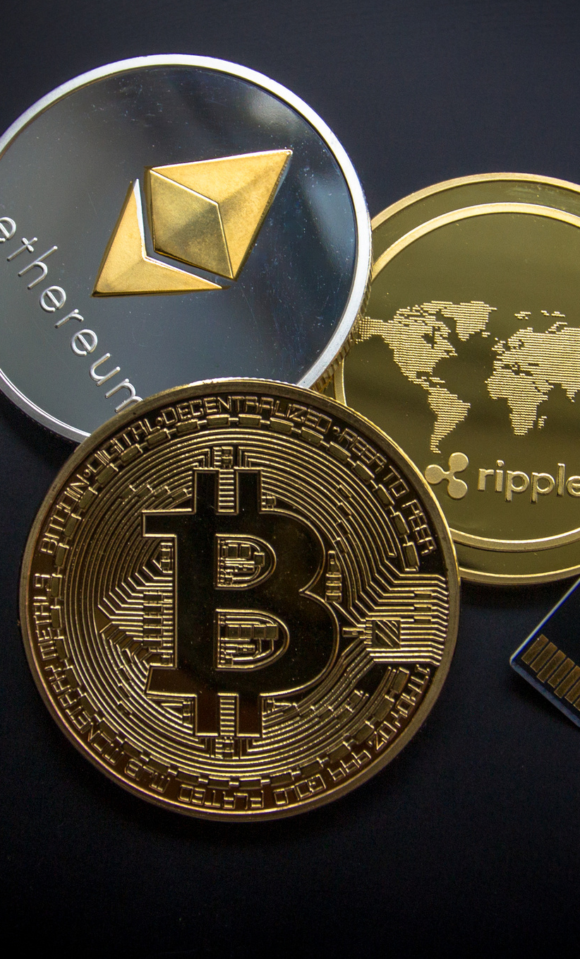
FUTURE OF CRYPTOCURRENCY
The future is promising, showing more opportunities for positive change and progress.
Ban can and will create a panic situation.
Indian authorities do not have the capacity to identify and track down these markets.
If a ban is enforced, crypto-assets would be sold on the black market

Slide 5
“CRYPTOCURRENCY IN INDIA: THE PAST PRESENT AND UNCERTAIN FUTURE” BY ET TECH (MARCH 9 2021)
LITERATURE
REVIEW
“CRYPTOCURRENCY AND ITS RISING IMPORTANCE IN INDIA IN 2021” BY DISHA GANGULI (MAY 14 2021)
“WHAT’S DRIVING DEMAND FOR CRYPTOCURRENCIES IN INDIA” BY KOUSTAV DAS (AUGUST 25 2021)
“WHY INDIA SHOULD BUY BITCOIN” BY BALAJI SRINIVASAN (FEBRUARY 4 2021)
“HERE IS WHY A BAN ON CRYPTOCURRENCIES MAY NOT EVEN BE POSSIBLE” BY BUSINESS INSIDER INDIA BUREAU (MAY 19, 2021)

Slide 6
METHODOLOGY
HOW DID WE GET THERE?
Primary Research : Quantitative research method approach via a survey containing close ended questions.
Our Survey Objective : to find an estimate of the respondent’s awareness about Cryptocurrency among various age groups, gender, and occupational status and a relation between them.
We later performed that Chi-Square test of independence.

Slide 7
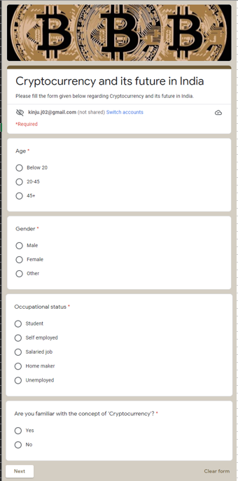
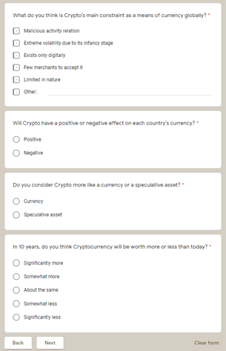
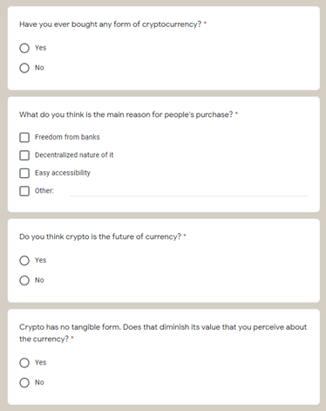
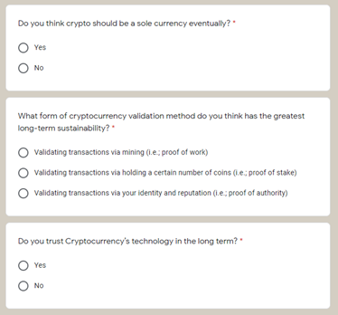
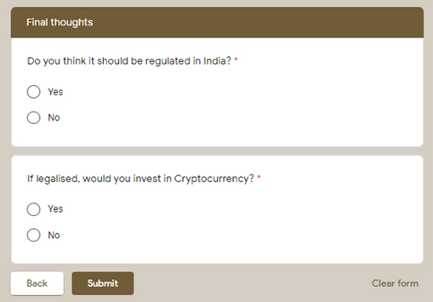
QUESTIONNAIRE
FOR PEOPLE WHO ARE AWARE ABOUT CRYPTO

Slide 8
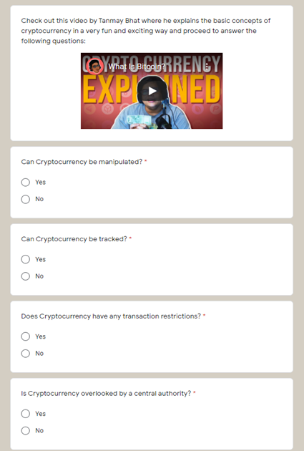
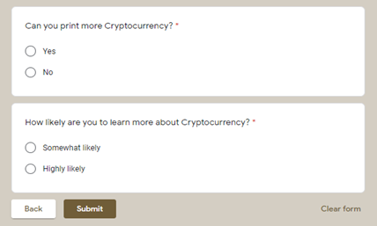
FOR PEOPLE WHO ARE
NOT AWARE ABOUT CRYPTO

Slide 9
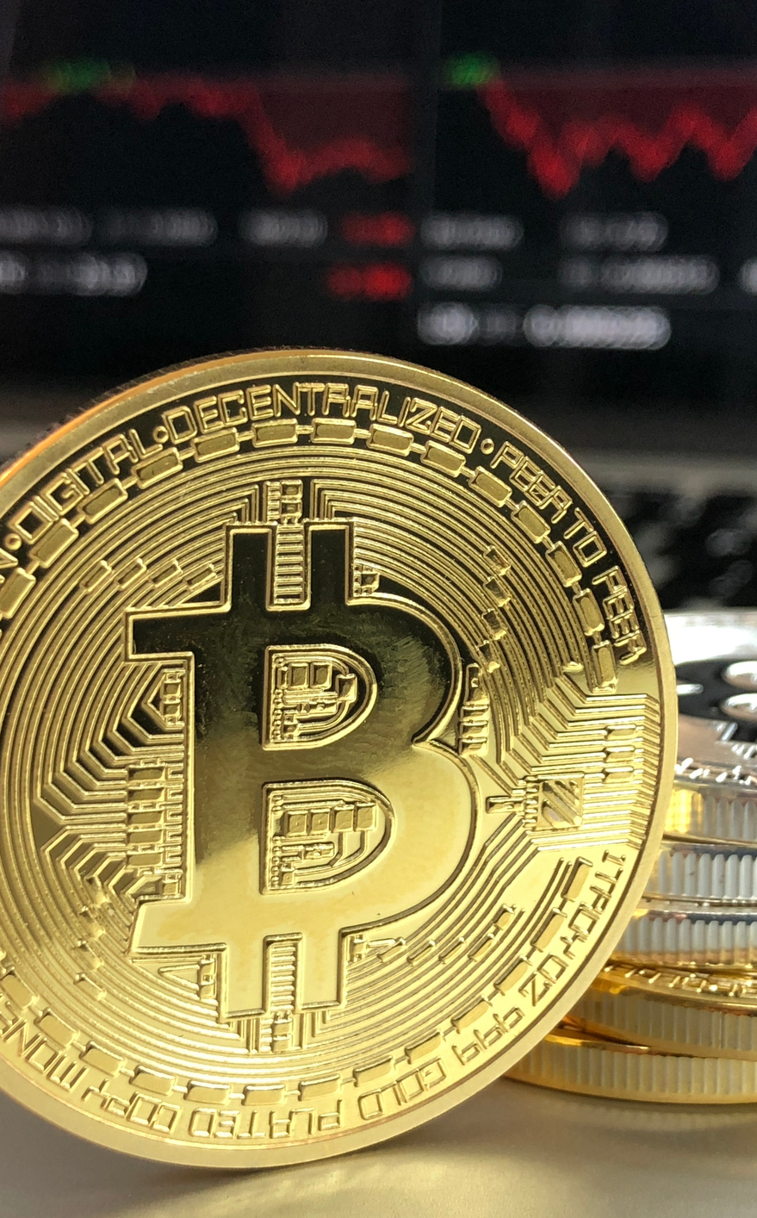
RESULTS
The variables that are not independent, implying there is some relation between them are:
Possession of Cryptocurrency and the respondent's Occupational status.
Awareness about Cryptocurrency and the respondent’s occupational status.
Age groups and awareness about Cryptocurrency.
The respondent's assumption on the effect of Cryptocurrency and their plan on investing in the future.

Slide 10
CONCLUSION
3
2
More and more sellers are accepting payments for different types of cryptocurrencies.
1
The number of investors in cryptocurrency is increasing rather swiftly over the last few years despite no regulatory response from the Indian government.
The future of the cryptocurrency concept is promising.

Slide 11
THANK YOU!
EVERY INFORMED PERSON NEEDS TO KNOW ABOUT BITCOIN BECAUSE IT MIGHT BE ONE OF THE WORLD’S MOST IMPORTANT DEVELOPMENTS.
LEON LOUW, TWO-TIME NOBEL PEACE PRIZE NOMINEE

